Slide 1

PROJECT : COM - 312 MEMORY MANAGEMENT SIMULATOR
Submitted by
VANSHAK CHHABRA(2021A1R153)
SURAJ PANDIT(2021A1R164)
AMANDEEP SINGH(2021A1R168)
SAHIL CHIB(2021A1R160)
Submitted To:
MR. SAURABH SHARMA
Assistant Professor
DEPARTMENT OF COMPUTER SCIENCE AND ENGINEERING
MIET(Autonomous), JAMMU

Slide 2

Table of Contents:
INTRODUCTION
MEMORY MANAGEMENT
KEY TERMS
CODE

Slide 3
INTRODUCTION
In a multiprogramming computer, the operating system resides in a part of memory and the rest is used by multiple processes. The task of subdividing the memory among different processes is called memory management. Memory management is a method in the operating system to manage operations between main memory and disk during process execution. The main aim of memory management is to achieve efficient utilization of memory.

Slide 4
Need for memory management
Allocate and de-allocate memory before and after process execution.
To keep track of used memory space by processes.
To minimize fragmentation issues.
To proper utilization of main memory.
To maintain data integrity while executing of process.

Slide 5
Key terms
Best fit : In this strategy, memory is scanned from the beginning and searched for the set of holes that have the size equal to or greater than the size of process. The smallest hole that is big enough to accommodate the process is allocated.
Worst fit: In this strategy, memory is scanned from the beginning and searched for the entire set of holes. Now, the hole that has the largest size among them is allocated to the process.
First fit: In this strategy, memory is scanned from the beginning and searched for the hole that is large enough to accommodate the process. As soon as the first hole is identified, it is allocated to the process.
Next fit: The next fit is a modified version of first fit. It begins as the first fit to find a free partition but when called next time it starts searching from where it left off, not from the beginning.
Fixed partition: In this partitioning, the number of partitions in RAM is fixed but the size of each partition may or may not be the same. As it is a contiguous allocation, hence no spanning is allowed.
Variable partition: In contrast with fixed partitioning, partitions are not made before the execution or during system configure.

Slide 6
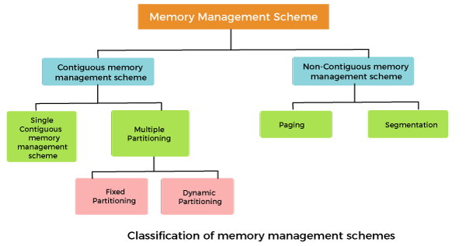
https://www.javatpoint.com/memory-management-operating-system

Slide 7
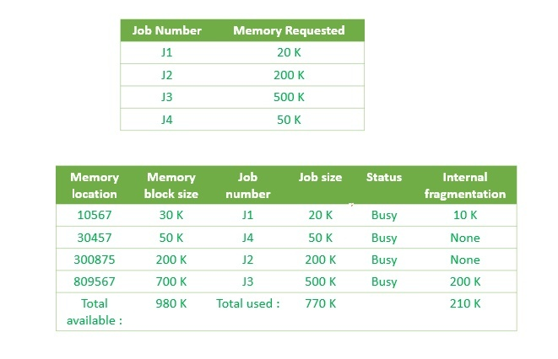
Best fit
This method keeps the free/busy list in order by size – smallest to largest. In this method, the operating system first searches the whole of the memory according to the size of the given job and allocates it to the closest-fitting free partition in the memory, making it able to use memory efficiently. Here the jobs are in the order from smallest job to largest job.

Slide 8
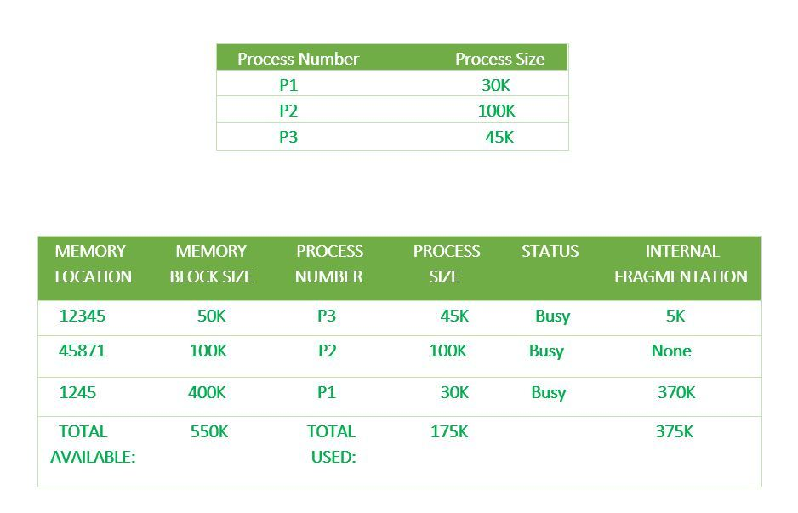
Worst fit
In this allocation technique, the process traverses the whole memory and always search for the largest hole/partition, and then the process is placed in that hole/partition. It is a slow process because it has to traverse the entire memory to search the largest hole.

Slide 9
Next fit
The next fit is a modified version of first fit. It begins as the first fit to find a free partition but when called next time it starts searching from where it left off, not from the beginning. This policy makes use of a roving pointer. The pointer moves along the memory chain to search for the next fit. This helps in, to avoid the usage of memory always from the head (beginning) of the free blockchain.

Slide 10
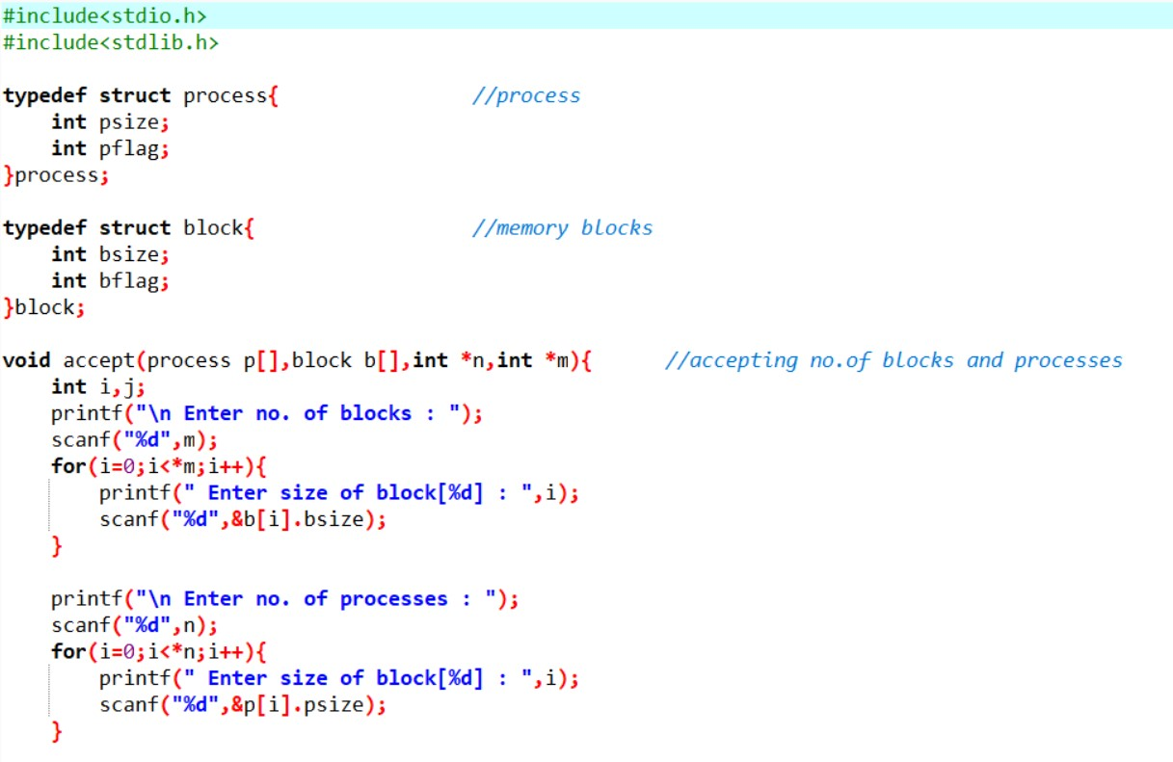
CODE

Slide 11
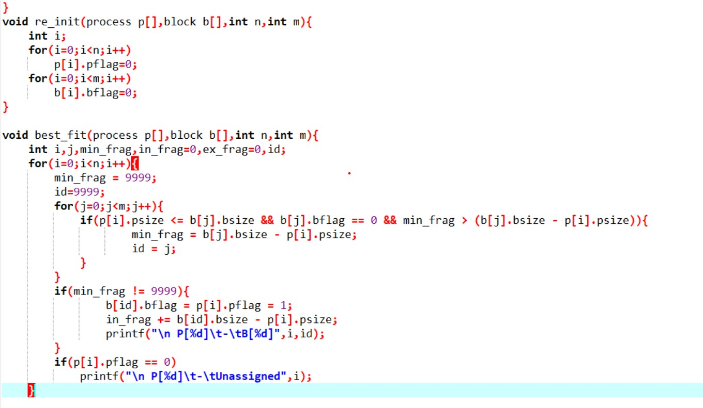

Slide 12
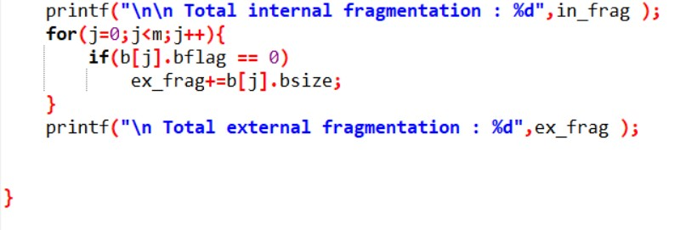

Slide 13
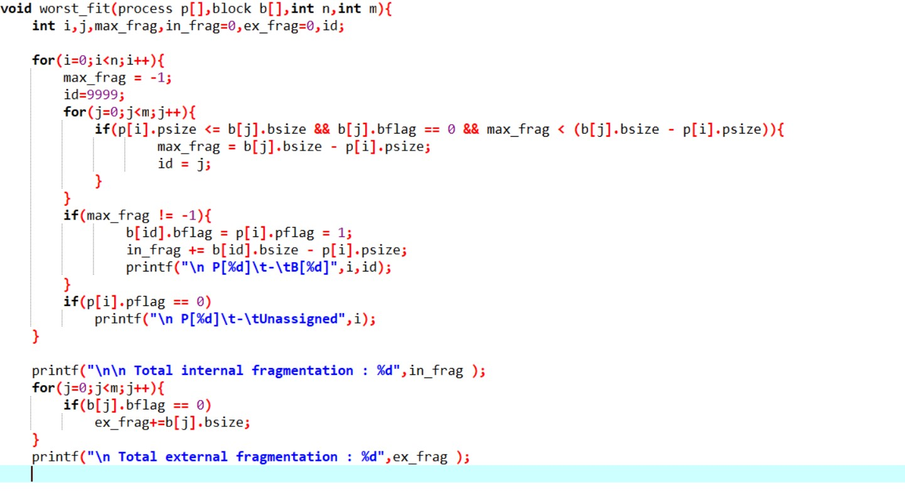

Slide 14
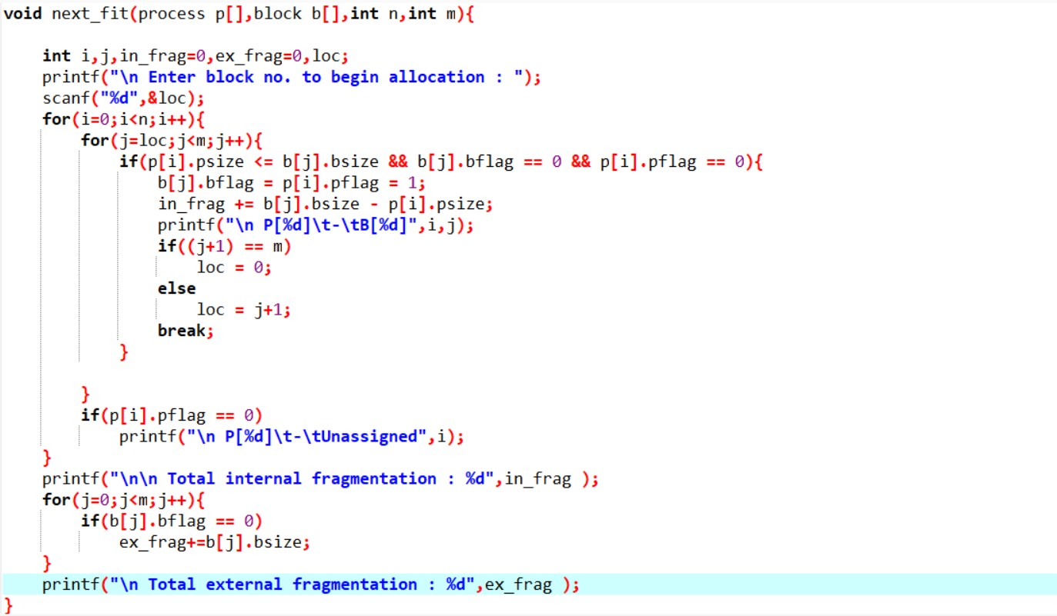

Slide 15
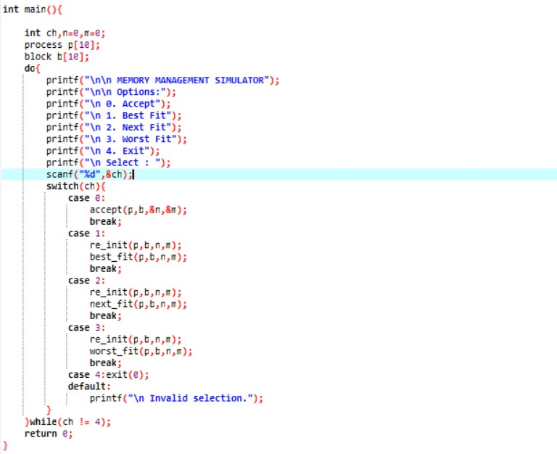

Slide 16
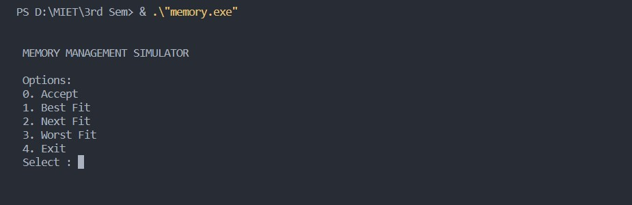
OUTPUTS:

Slide 17
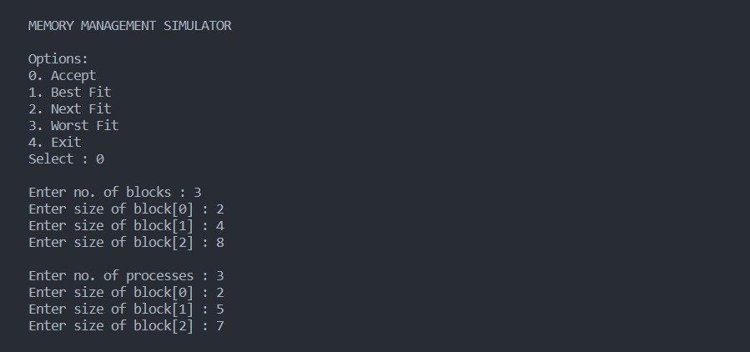
Accept

Slide 18
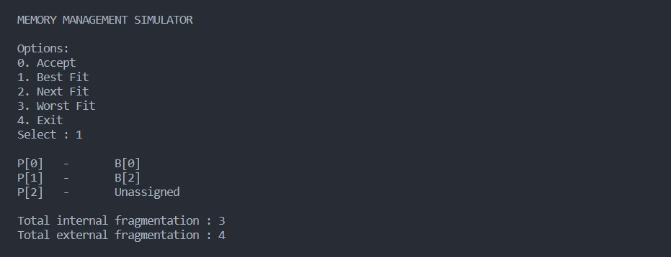
Best fit

Slide 19
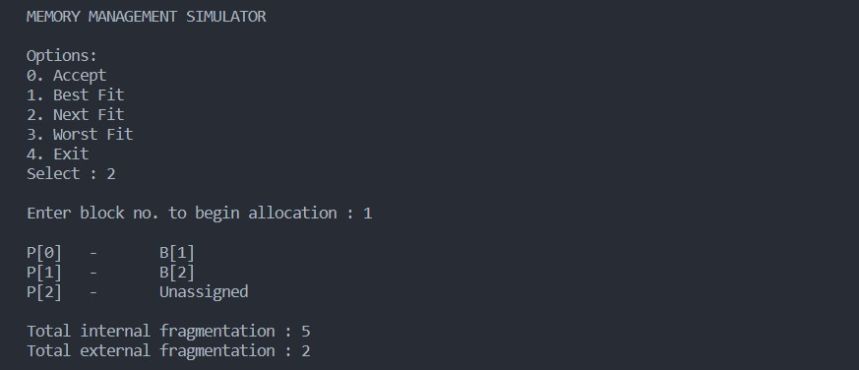
Next fit

Slide 20
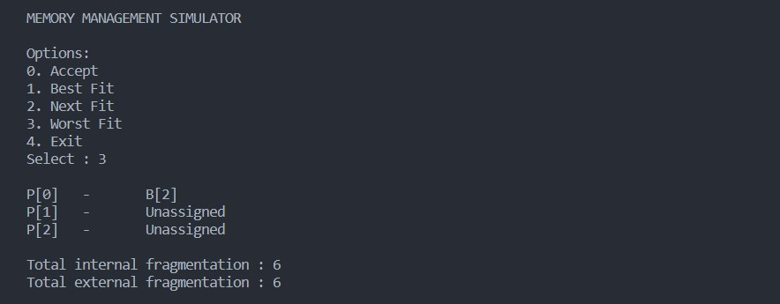
Worst fit

Slide 21

THANK YOU

